Slide 1
Penetration Testing With Python
IT-TECH Final Exam 2017 – Thor Kristiansen

Slide 2

TOC
Why Python?
The Five Phases of Penetration Testing
New since 18th December version
Script Structure
Code is Poetry
Examples of Banner Grabbing
Demonstration
Questions?
EOF

Slide 3
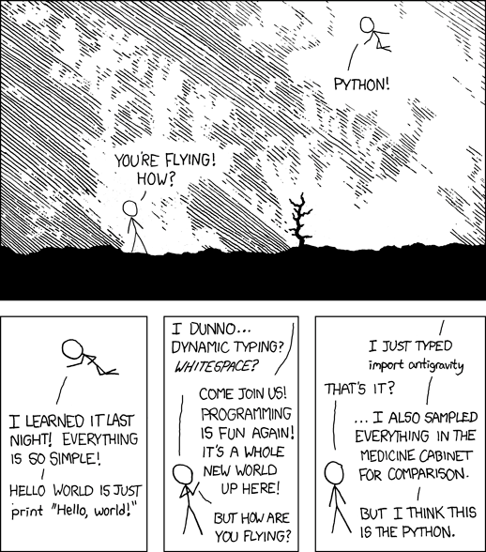
Why Python?
Python is fast, despite being an interpreted language
Python is broad e.g. Django for web dev
Python is easy AND powerful at the same time

Slide 4

The Five Phases of Penetration Testing*
Phase 1 | Reconnaissance
Phase 2 | Scanning
Phase 3 | Gaining Access
Phase 4 | Maintaining Access
Phase 5 | Covering Tracks
*Source: Cybrary.it

Slide 5
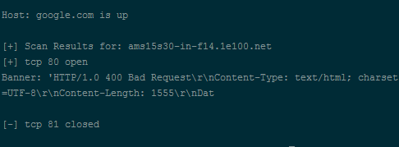
Updates since 1st exam
Moved from optparse to argparse
Input type checking
Bug fixes
Proper error handling
New nmap call function
New udp scan option

Slide 6
Script Structure
Main()
Nmappingscan
Udpscan
Portscan
Connscan

Slide 7
Modules
Argparse:
” The argparse module makes it easy to write user-friendly command-line interfaces.”
New in Python 3.2
Socket:
A module to provide access to the socket interface.
Threading:
” Module constructs higher-level threading interfaces on top of the lower level _thread module.”
Nmap:
” A python class to use nmap and access scan results from python3.”

Slide 8

Important Socket Module Constants
socket.AF_INET:
For IP version 4
socket.AF_INET6:
For IP version 6
socket.SOCK_STREAM:
For TCP
socket.SOCK_DGRAM:
For UDP
socket.SOCK_RAW:
Raw, meaning no protocol. Used for package sniffing

Slide 9
Exceptions
Importerror:
”Raised when the import statement has troubles trying to load a module.”
Runtimeerror:
” Raised when an error is detected that doesn’t fall in any of the other categories.”
Connectionerror:
” A base class for connection-related issues.”
Socket.timeout:
Special exception only works when Socket module is imported.
Relies on socket.settimeout()
Windowserror:
To handle errors that are raised by windows and passes back the error num and information.

Slide 10
Code is Poetry
Hope You love it!

Slide 11
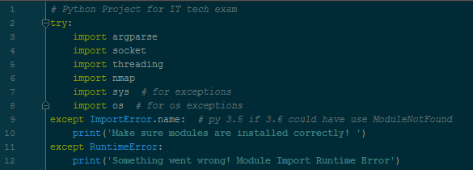
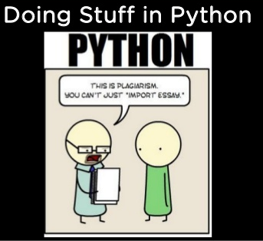
Importing Modules

Slide 12
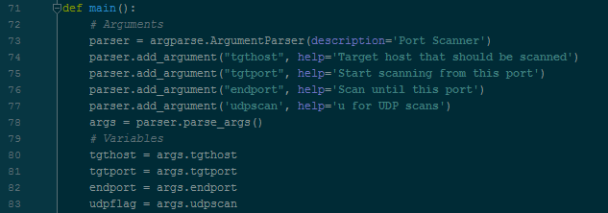
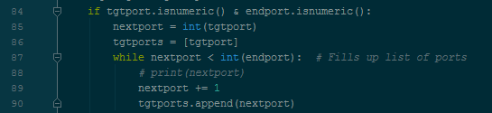
Main()

Slide 13
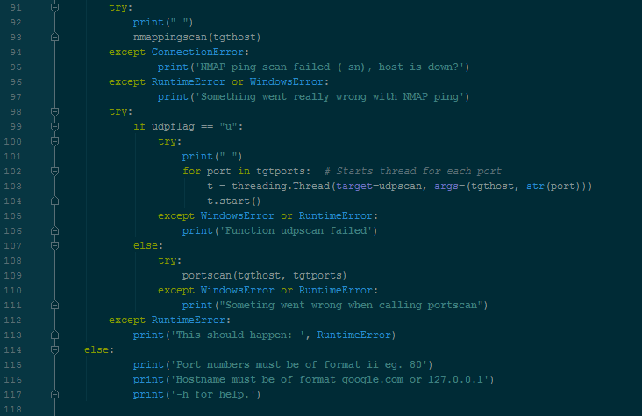
More Main()

Slide 14
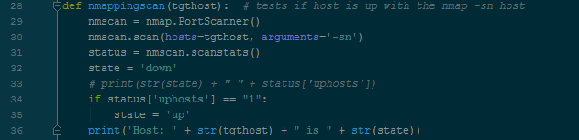
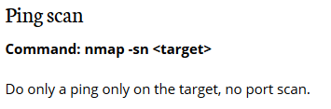
Nmappingscan

Slide 15
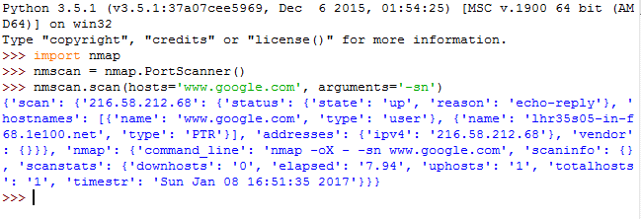
Nmscan.scanstats()

Slide 16
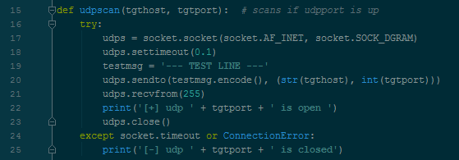
Udpscan

Slide 17
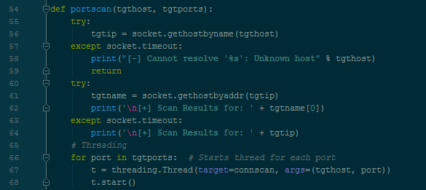
Portscan

Slide 18
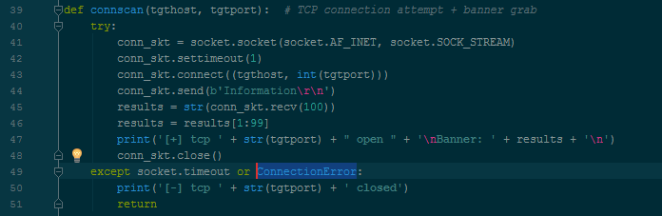
Connscan

Slide 19
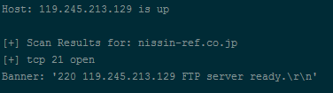
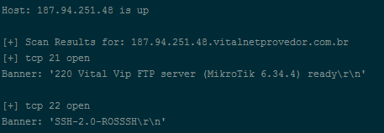
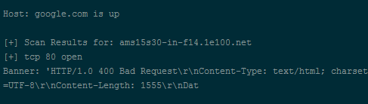
Examples of Banner Grabbing

Slide 20
Demonstration

Slide 21
Questions?

Slide 22
EOF
Thank You for listening!

